Slide 1
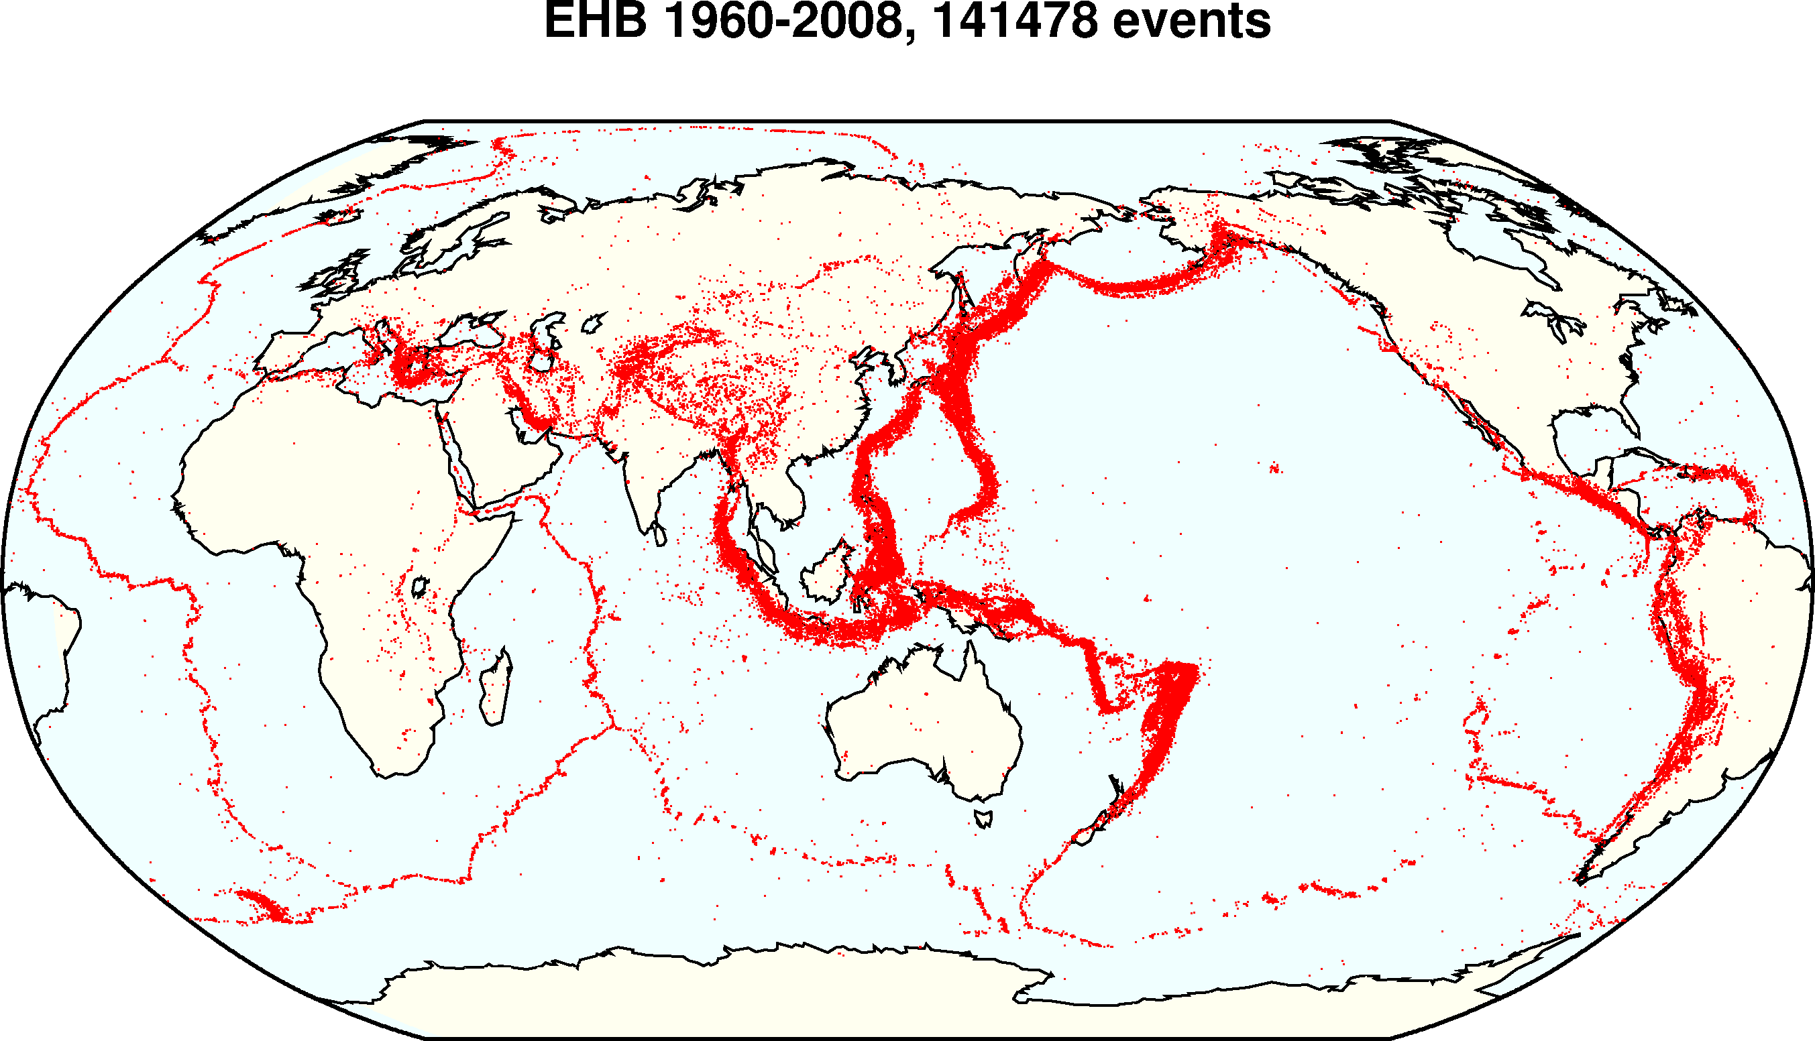
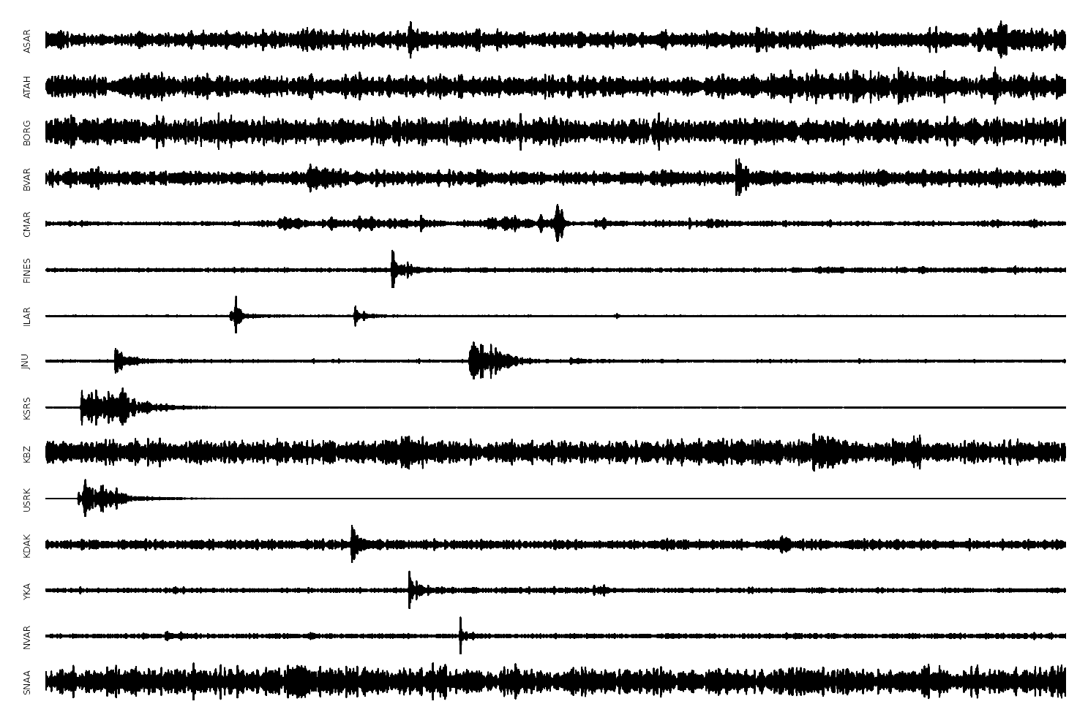
Bayesian Seismic Monitoring from Raw Waveforms
Dave Moore
With:
Stuart Russell (UC Berkeley)
Kevin Mayeda (UC Berkeley)
Stephen Myers (LLNL)
Notes:
What is seismic monitoring? Why am I talking about it in an AI seminar? I argue it is actually a *perception* problem, like speech recognition or computer vision. There is real structure out there in the world, objects or in this case seismic events, and we don’t observe it directly, we only observe ground motion measured by seismometers in different locations that record seismic waveforms. So the task is to go from this indirect, noisy, clutter perceptual representation to infer the real structure in the world, the seismic events that generated it.

Slide 2
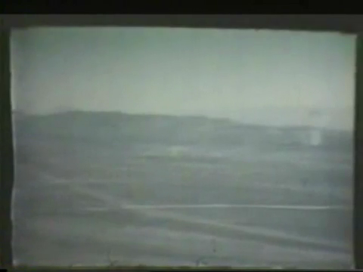

Slide 3
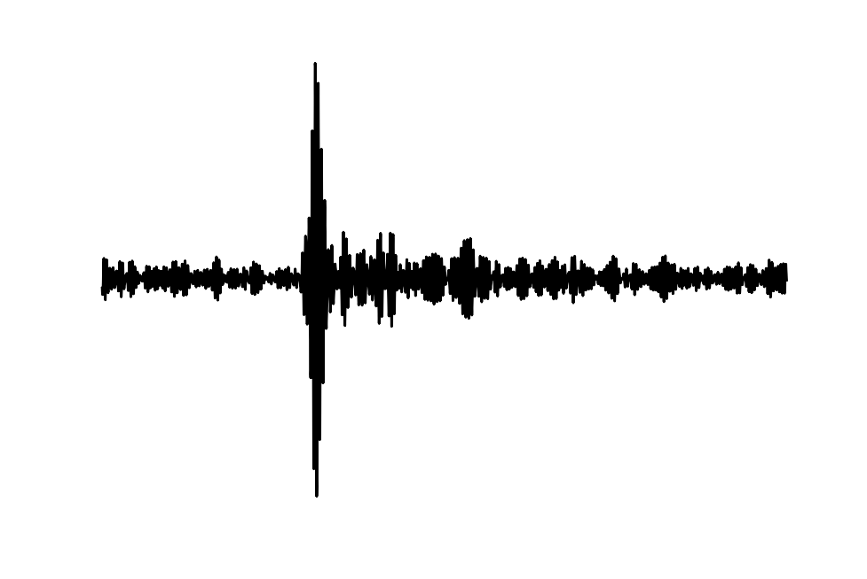
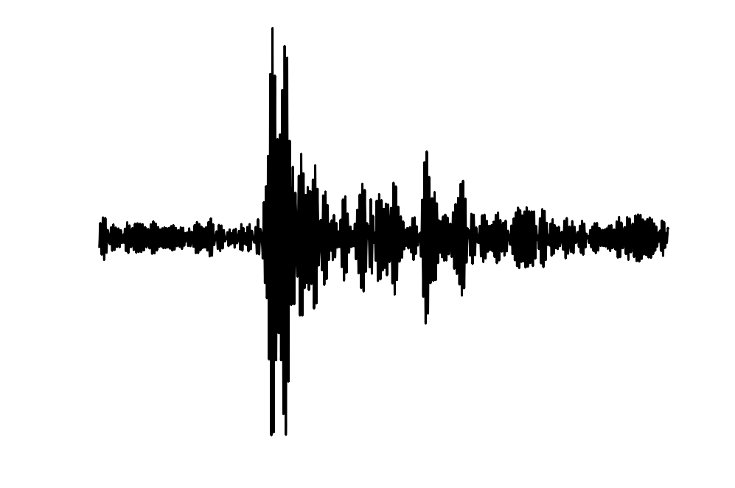
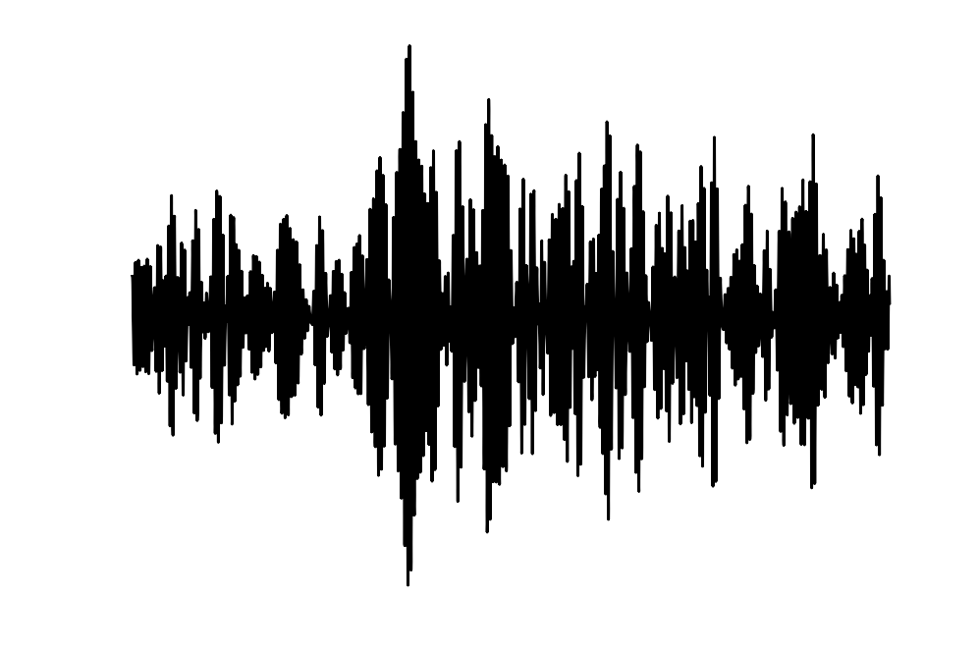
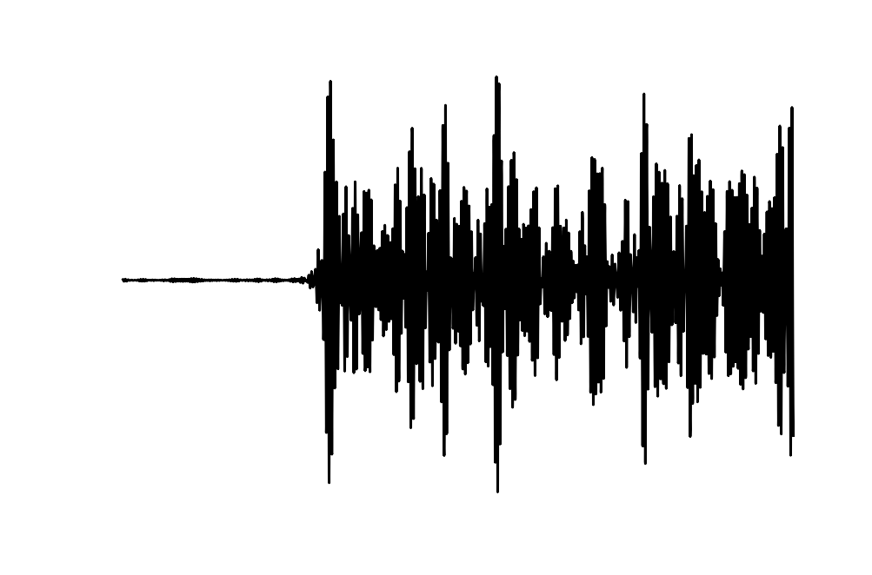
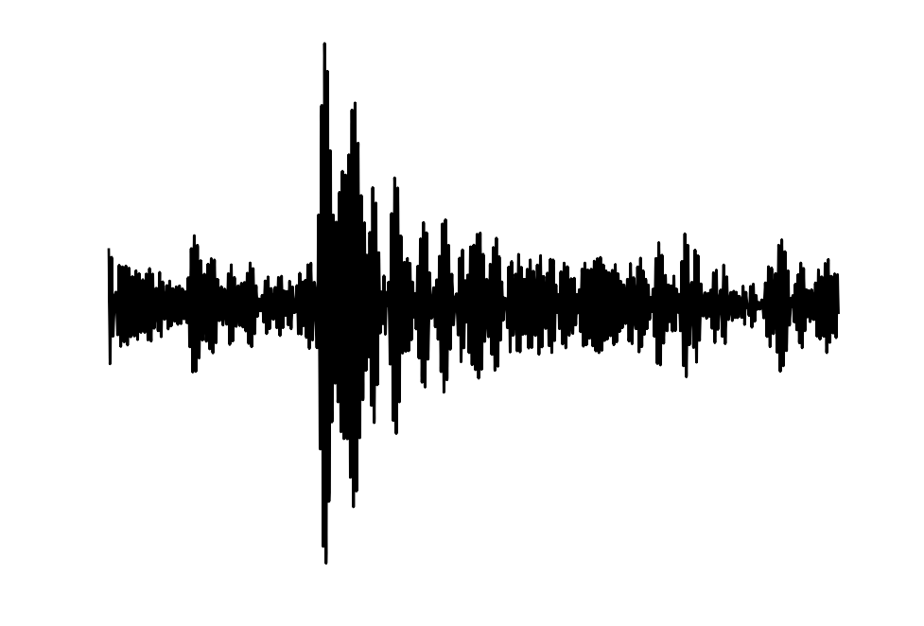
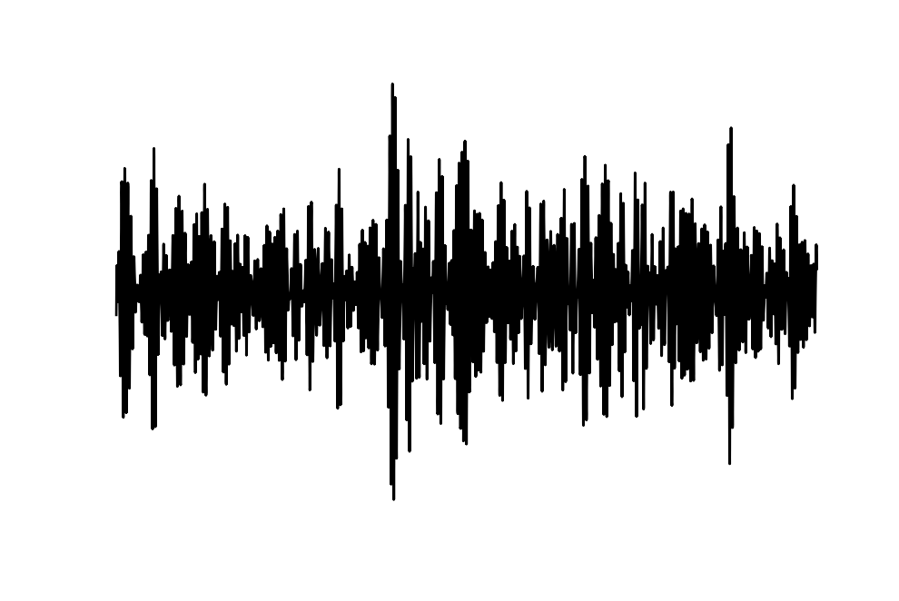
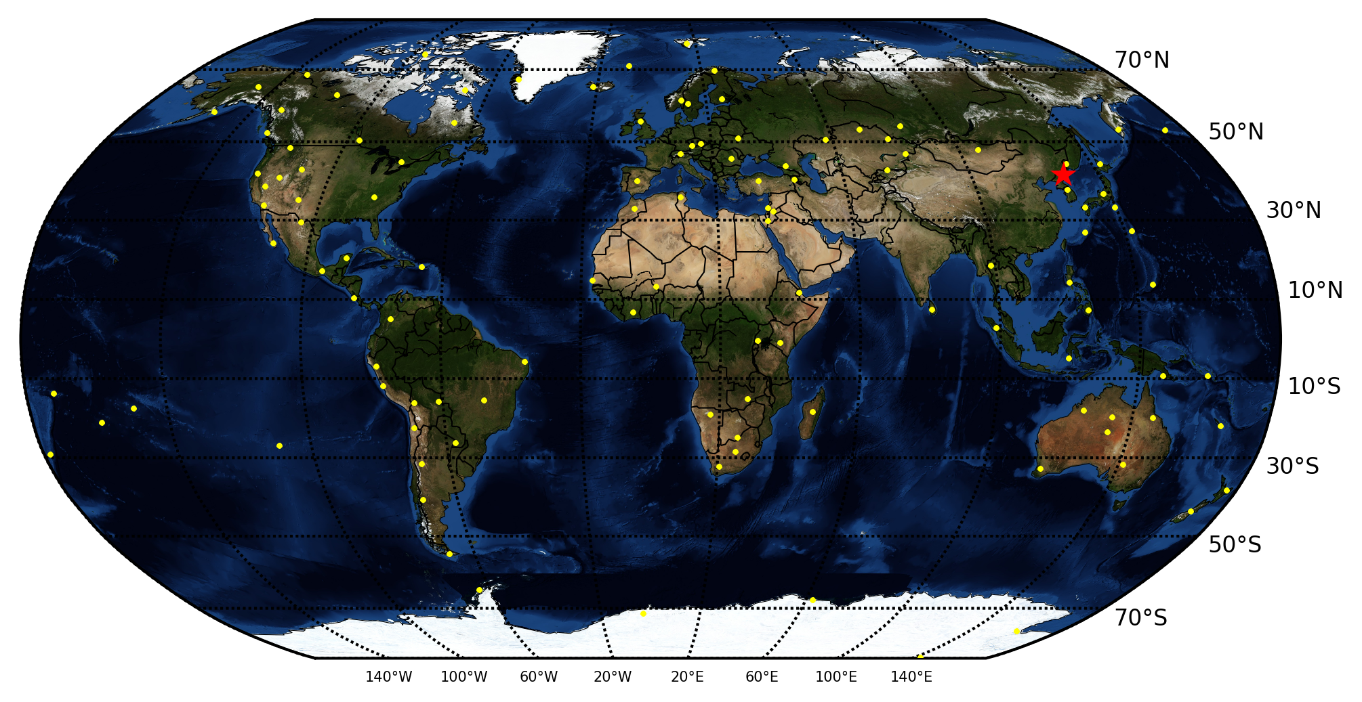
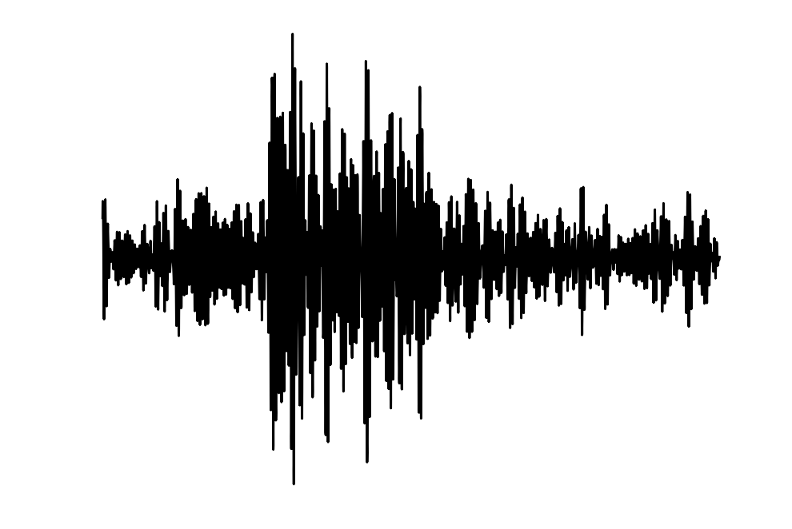
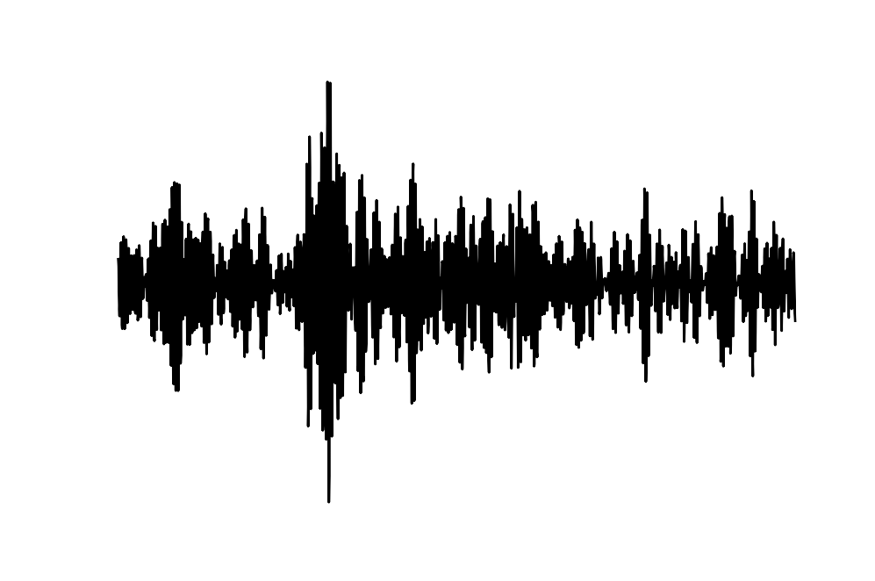
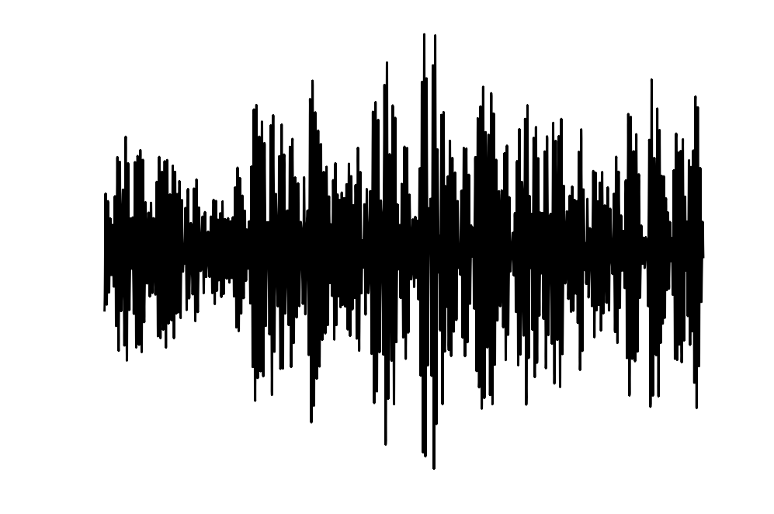
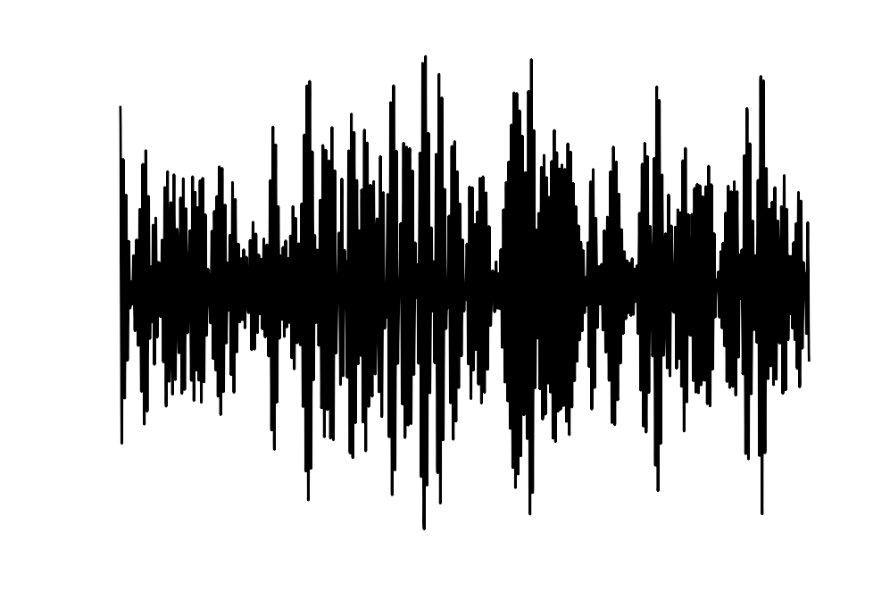
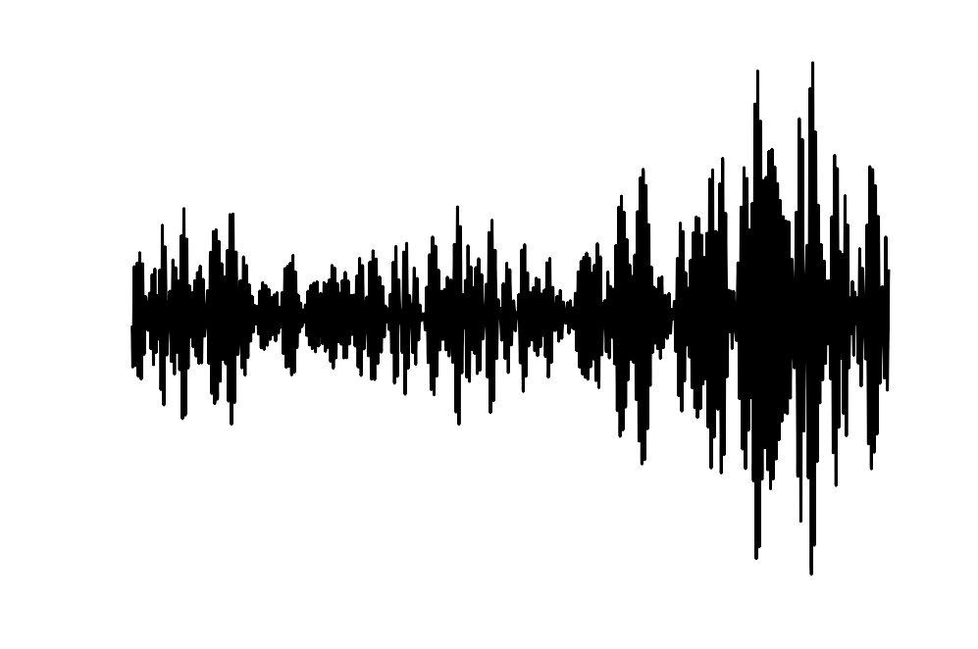
May 25, 2009
North Korean test
Notes:
Each of these waveforms is 30s before the predicted P arrival, then 70s after

Slide 4
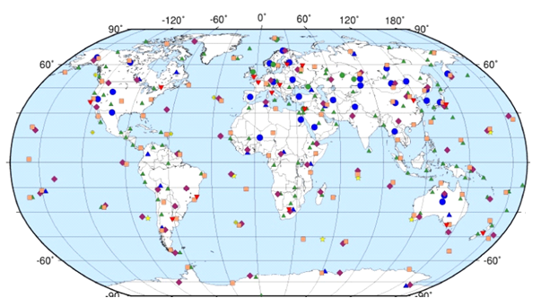
Comprehensive Test Ban Treaty (CTBT)
Bans all testing of nuclear weapons
110 seismic stations in IMS (International Monitoring System)
Allows outside inspection of 1000km²
seismic stations
other stations
Need 9 more ratifications including US, China
US Senate refused to ratify in 1999
“too hard to monitor”

Slide 5
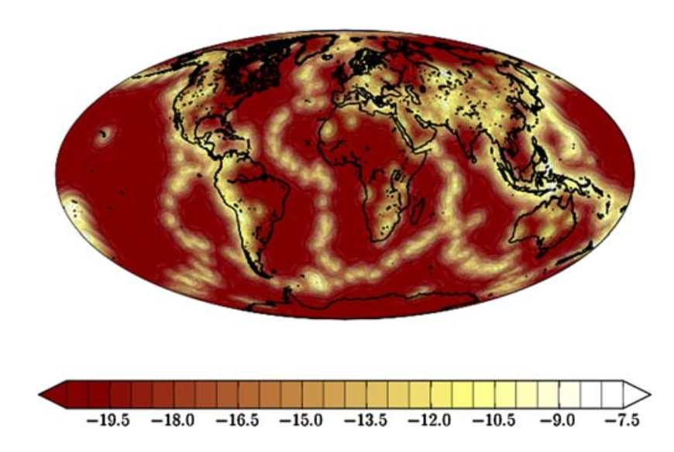
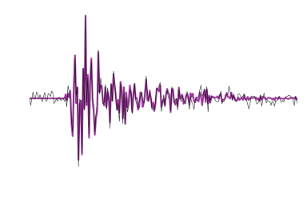
Bayesian monitoring
P(events) describes prior probability of events
P(signals | events) describes forward model based on knowledge of seismology and seismometry
Given new signals, compute posterior probability
P(events | signals) ∝ P(signals | events) P(events)
Notes:
mention inference
So as I said, I’ll just start with some background on Bayesian methods. To build a Bayesian model, there are a few components that you have to specify. First, you need a prior probability distribution which reflects the historical empirical frequencies of events and location/magnitude distribution of events. Then you also have to specify a forward model – statisticians sometimes call this a likelihood function or generative process -- which says, given some particular hypothesis about what events have taken place, what sorts of signals am I likely to observe? And this model can reflect expert knowledge, of the physics of wave propogation and the response of our measurement instruments and generally what we're likely to observe. One thing to note here is that when I say “forward model” throughout this talk, I mean a *statistical* model, which, more than predicting one particular signal, assigns a probability to every signal we might observe.
And both the forward model and the prior distribution can have parameters which we learn from historical data.
Finally given both these pieces, there's a theorem, Bayes' theorem, which says we just multiply the prior distribution by the forward model and re-normalize all the probabilities, and we get a posterior distribution which reflects mathematically, the probability of any given event sequence conditioned the signals that we observed. To find the most probable sequence of events, all we have to do now is maximize this function, (actually doing this can be computationally difficult but there are lots of approaches to inference algorithms).
Now the advantage of doing things this way is a totally rigorous, principled handling of uncertainty; our conclusions just follow naturally from the laws of probability theory. And we're not picking and choosing, saying "this evidence seems relevant", the posterior probabilities take into account all of the evidence we observe.
And a really big important thing is that the Bayesian framework separates the physical model from the inference algorithm. Any sound inference algorithm will just find the most likely event sequence given the evidence, under the model. So if one of you guys, or any geophysicist out there goes in and says, well, your model is wrong and it should actually account for this phenomenon, then just by improving the model we've automatically improved the output of the system; no need to go through and change all the algorithms.
----- Meeting Notes (10/20/13 16:49) -----
Delete all subscripts

Slide 6
Bayesian monitoring
Model makes assumptions explicit. Better models => better results.
Encodes scientific understanding of domain; generalizes beyond training data.
Principled handling of uncertainty:
Integrates multiple sensors
Combines top-down and bottom-up reasoning.
Uses all the data (e.g., negative evidence)

Slide 7
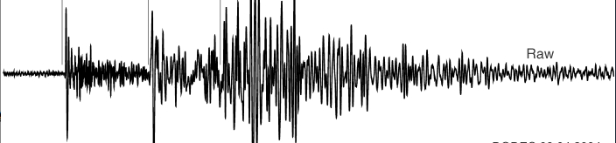
Detection-based and signal-based monitoring
waveform signals
Notes:
Now when we actually build a monitoring system, we have to choose how much of the data and the physics to include in our model. In monitoring we always start with the waveforms themselves, and

Slide 8
Detection-based and signal-based monitoring
detections
station
processing
waveform signals
Notes:
traditionally there is some station processing that looks at the waveform and tries to pick out a set of detections.

Slide 9
Detection-based and signal-based monitoring
events
Traditional
Monitoring
(GA / SEL3)
detections
station
processing
waveform signals
Notes:
Then in a system like GA, you keep moving up: you take these detections and try to construct a set of events.

Slide 10
Detection-based and signal-based monitoring
events
Traditional
Monitoring
(GA / SEL3)
model
inference
NET-VISA
detections
station
processing
waveform signals
NET-VISA = detection-based
Notes:
Now one way to be Bayesian is to build a forward model that starts with an event hypothesis and just tries to predict the detections that those events would generate. Then when you do inference you go backwards from the detections up to recover the events.

Slide 11
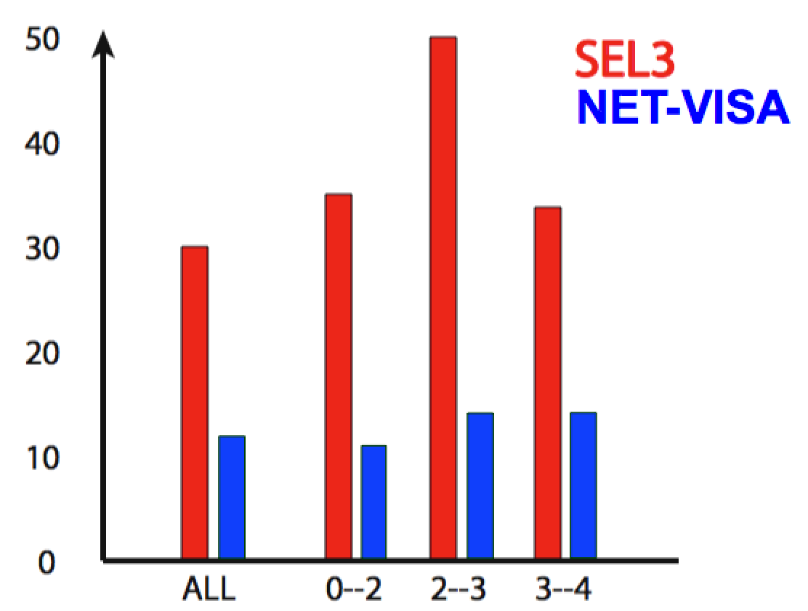
Detection-Based Bayesian Monitoring (NET-VISA, Arora et al.)
IMS global evaluation: ~60% reduction in missed events vs. GA/SEL3.
Identifies additional events missed by human analysts (LEB).
Currently being evaluated for deployment at the IDC.
Can we do better?
Missed events
Magnitude range (mb)
Notes:
This is the design choice that NET-VISA makes, it's detection-based Bayesian monitoring, which Nimar Arora has worked on. And it turns out that even being Bayesian in this limited setting still works really well: it misses 60% fewer events than the SEL3 bulletin which was the previous state of the art, across a range of magnitudes, and it even picks up some events which the human analysts miss but which we can corroborate by looking at regional catalogs. And that's currently being evaluated for production deployment at the IDC.
So we think this is a great proof of concept for the Bayesian approach, and it's natural to ask, what's next? How can we do better?

Slide 12
Detection-based and signal-based monitoring
events
Traditional
Monitoring
(GA / SEL3)
model
inference
NET-VISA
detections
station
processing
waveform signals
NET-VISA = detection-based
Notes:
The natural way to do better is to build a model that uses more of the available data, and includes a richer idea of the physics of the situation.

Slide 13
Detection-based and signal-based monitoring
events
Traditional
Monitoring
(GA / SEL3)
model
inference
inference
model
NET-VISA
detections
station
processing
SIG-VISA
waveform signals
NET-VISA = detection-based, SIG-VISA = signal-based
Notes:
The way we've done that is to use a forward model that goes from event hypothesis directly down to predict the signals themselves, so when we do inference we start from the raw signals and go backwards trying to infer events directly, without any station processing. We call this system SIG-VISA.

Slide 14
Signal-based monitoring
Seismic physics 101:
Notes:
What aspects of the physics is it helpful to model? Of course we want to include the same sorts of things that a detection-based system would include, like a travel-time model and attentuation models, that make some assumptions about when phases should arrive and how much energy they'll carry. When we do Bayesian inference to invert these models, we'll turn out to get something that replaces traditional picking with a sort of soft template matching, and see that this even lets treat the whole global network as something analagous to a single big array that you can do beamforming on.
But another thing we can model is that waveforms themselves are spatially continuous, at least locally, so if you ahve two nearby events you'll expect them to generate similar waveforms at the same station. If you invert this assumption, you get waveform matching methods, and the potential to use waveform correlation for sub-threshold detections.
Finally we could also model continuity of travel-time residuals: if you have two nearby events the travel-time model is likely to make the same errors on both of them, so you can get their relative locations much more accurately than their absolute locations. If you invert this assumption you get methods like double-differencing.
What we'd like to do is include all of these assumptions about the physics in a single model, so when we do inference all of these effects fall out naturally.

Slide 15
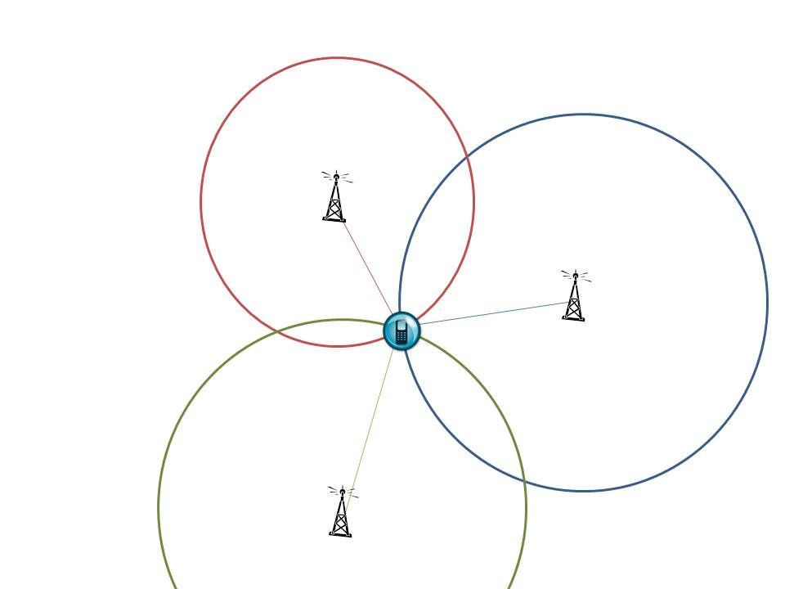
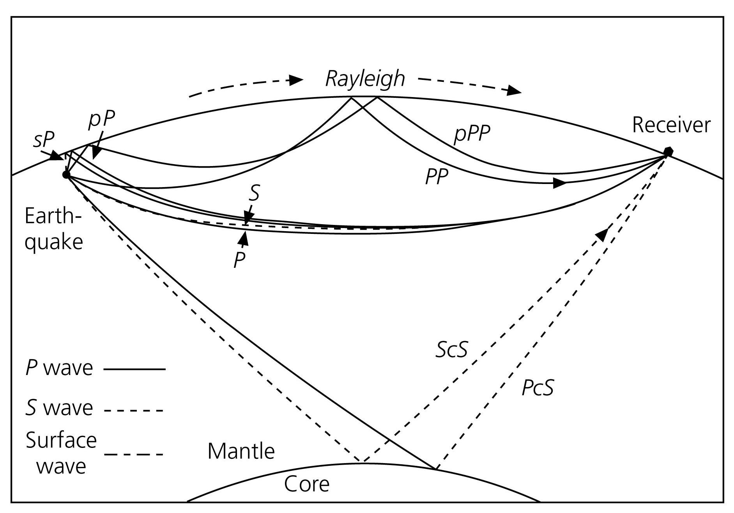
Signal-based monitoring
What aspects of seismic physics can we model?
Travel times
Inverted through inference -> multilateration
Multiple phase types
Distance-based attenuation
Frequency-dependent coda decay
Spatial continuity of waveforms
Notes:
What aspects of the physics is it helpful to model? Of course we want to include the same sorts of things that a detection-based system would include, like a travel-time model and attentuation models, that make some assumptions about when phases should arrive and how much energy they'll carry. When we do Bayesian inference to invert these models, we'll turn out to get something that replaces traditional picking with a sort of soft template matching, and see that this even lets treat the whole global network as something analagous to a single big array that you can do beamforming on.
But another thing we can model is that waveforms themselves are spatially continuous, at least locally, so if you ahve two nearby events you'll expect them to generate similar waveforms at the same station. If you invert this assumption, you get waveform matching methods, and the potential to use waveform correlation for sub-threshold detections.
Finally we could also model continuity of travel-time residuals: if you have two nearby events the travel-time model is likely to make the same errors on both of them, so you can get their relative locations much more accurately than their absolute locations. If you invert this assumption you get methods like double-differencing.
What we'd like to do is include all of these assumptions about the physics in a single model, so when we do inference all of these effects fall out naturally.

Slide 16
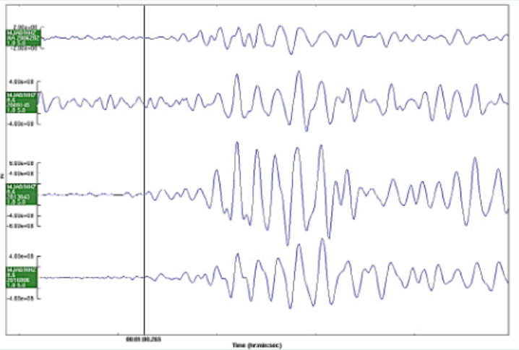
Spatial continuity of waveforms
Events in nearby locations generate correlated waveforms.
Inverted through inference:
Detects sub-threshold events
Locates events from a single station
Accurate relative locations from precise (relative) arrival times.
DPRK tests from
2006, 2009, 2013, 2016,
recorded at MJA0 (Japan)
(Bobrov, Kitov, Rozhkov, 2016)
Notes:
From http://presentations.copernicus.org/EGU2016-6620_presentation.pdf
MJAR is in Japan

Slide 17
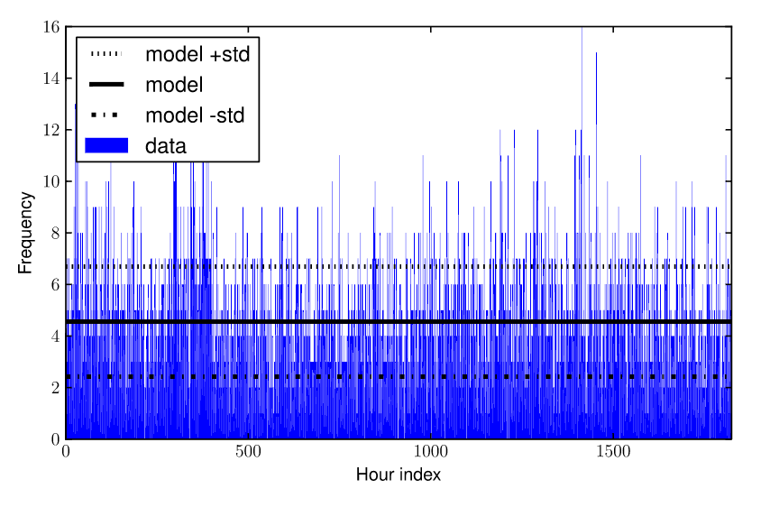
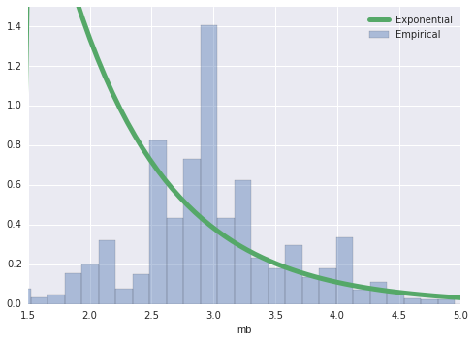
Event Priors
Rate: homogeneous Poisson process
(Arora et al, 2013)
Location: kernel density estimate + uniform
(Arora et al, 2013)
??
Magnitude: Gutenberg-Richter Law

Slide 18
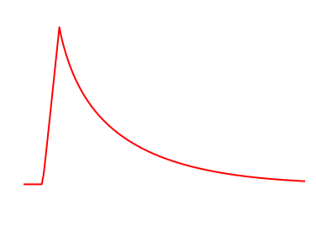
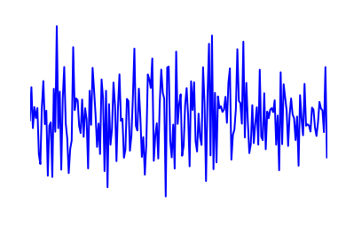
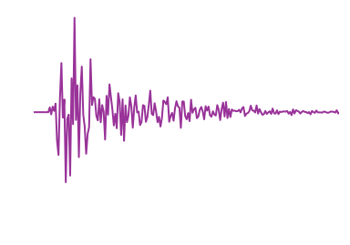
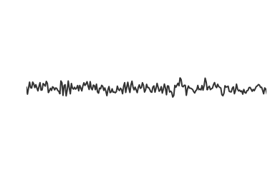
Signal model: single event/phase
Envelope template: parametric shape depends on event magnitude, depth, location, phase.
×
Repeatable modulation: the “wiggles”, depends on event location, depth, phase.
+
Background noise: autoregressive process at each station.
=
Observed signal: sum of all arriving phases, plus background noise.
Notes:
Start from the bottom
build?
pictures comfusing: no purple at bottom?

Slide 19
Parametric envelope representation
onset period
(linear)
Decay (poly-exponential)
amplitude
arrival time
(Mayeda et al. 2003, Cua et al. 2005 )
Use Gaussian processes (GPs) to model deviation of envelope parameters from physics-based deterministic models:
Arrival times: seismic travel-time model (IASPEI91)
Amplitude: Brune/Mueller-Murphy source models
Notes:
Parameters are interpretable and predictable.
Event time -> arrival time
Event magnitude -> signal amplitude
Other params also (roughly) modeled as linear functions of event magnitude and event-station distance
Von Neumann: with four parameters I can fit an elephant, with five I can make him wiggle his trunk…
Cua (2005) adds a peak duration, uses a polynomial decay
Mayeda (2003) uses a mix of polynomial (for peak) and exponential (for coda) decay
f(t) = \left\{\begin{array}{ll}
\alpha (t-t_0) / \tau & \text{ if } t-t_0 < \tau\\
\alpha (t-t_0+1)^{-\gamma} e^{-\beta (t-t_0)} &\text{ o.w.}\\
\end{array}\right.
\begin{array}{l}
t_0\text{: arrival time}\\
\tau\text{: onset period}\\
\alpha\text{: amplitude}\\
\gamma\text{: peak decay}\\
\beta\text{: coda decay}
\end{array}

Slide 20
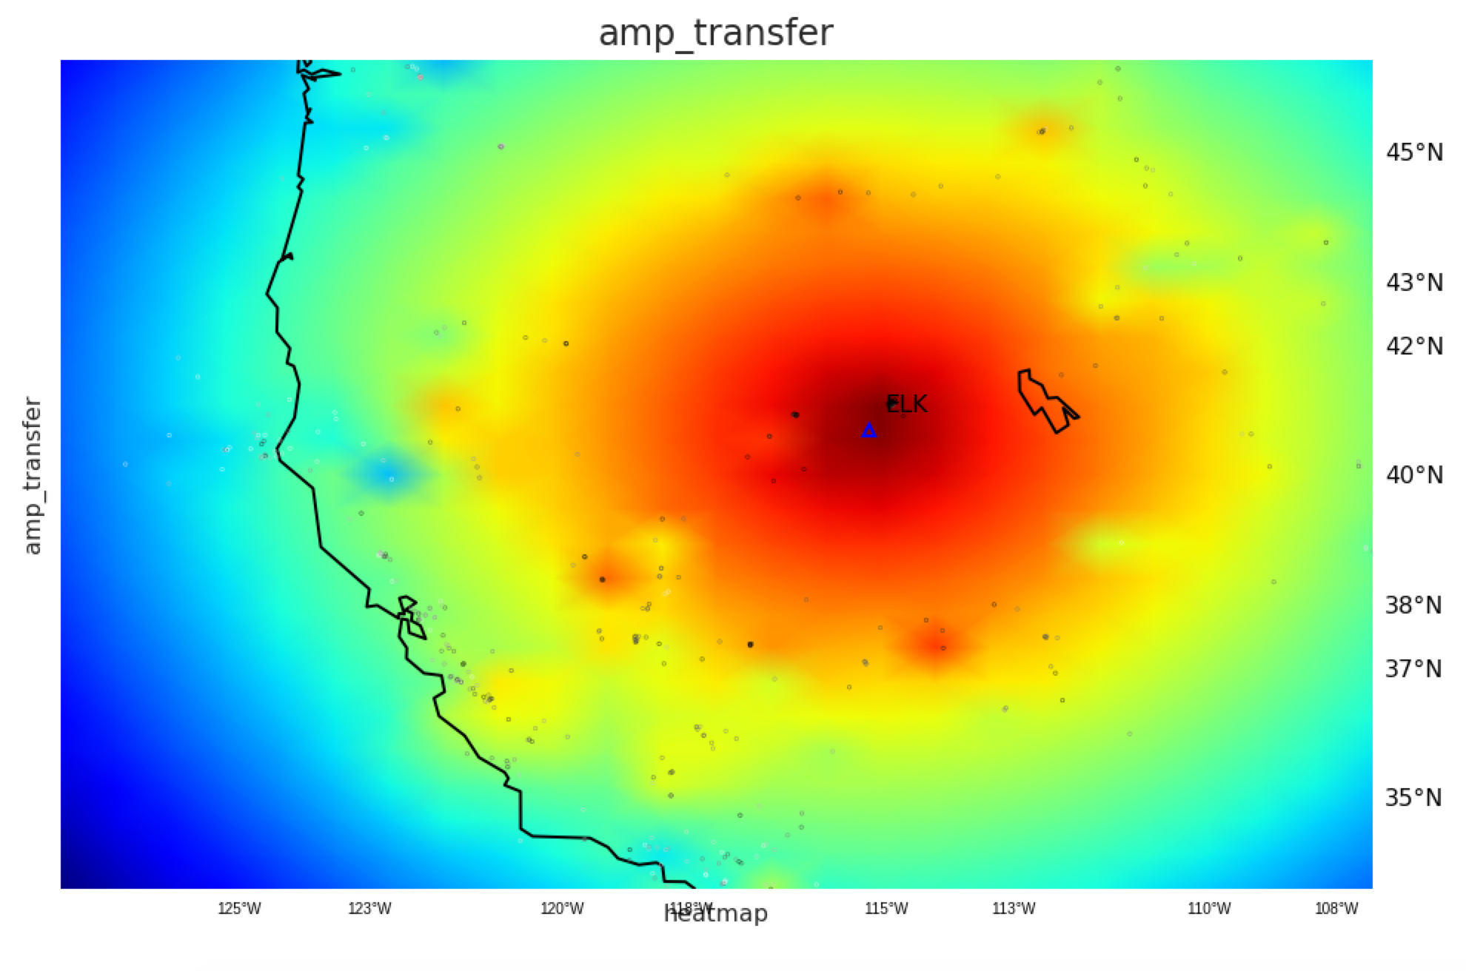
Example: GP amplitude model, western US (ELK)
Lg phase predicted log-amplitude

Slide 21
Generative model: single event/phase
Envelope template: parametric shape depends on event magnitude, depth, location, phase.
×
Repeatable modulation: the “wiggles”, depends on event location, depth, phase.
+
Background noise: autoregressive process at each station.
=
Observed signal: sum of all arriving phases, plus background noise.
Notes:
Start from the bottom
build?
pictures comfusing: no purple at bottom?

Slide 22
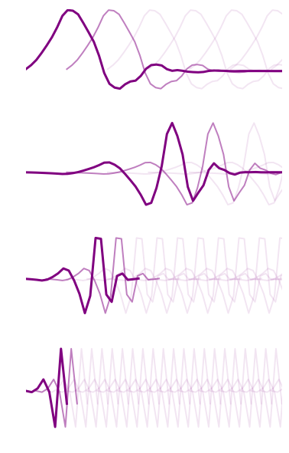
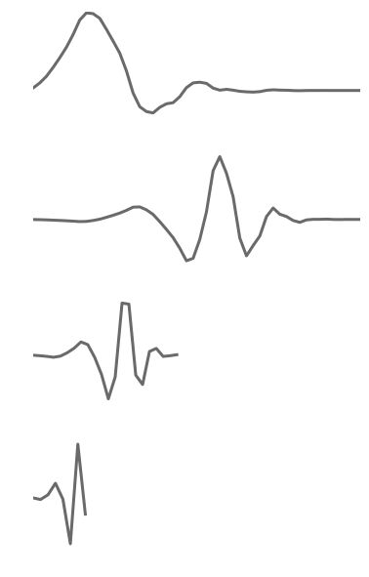
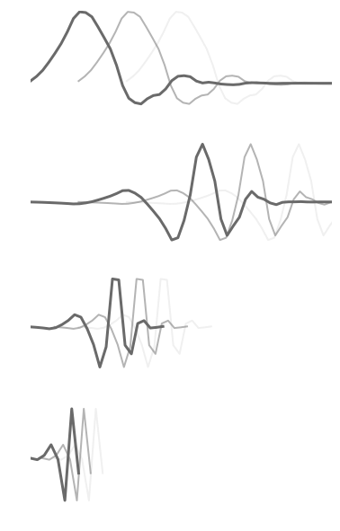
Repeatable modulation signal
GP
prior
coefs
·
Basis coefficients (wavelets) from a Gaussian process (GP) conditioned on event location.
Result: nearby events generate similar signals.
Daubechies db4
wavelet basis
Notes:
show example of
- wavelet coefficients
also explain that it doesn't matter terribly, we just need a basis

Slide 23
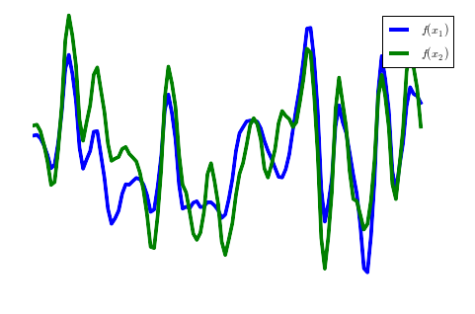

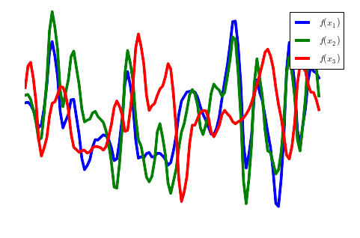
Repeatable modulation signals
x₁
x₂
x₃
Signals from 45 wavelet coefficients sampled indep. from GP prior.
Notes:
http://www.yourchildlearns.com/online-atlas/images/map-of-united-states-2.gif

Slide 24
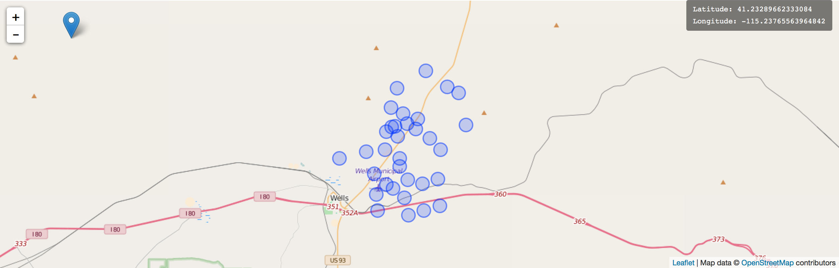
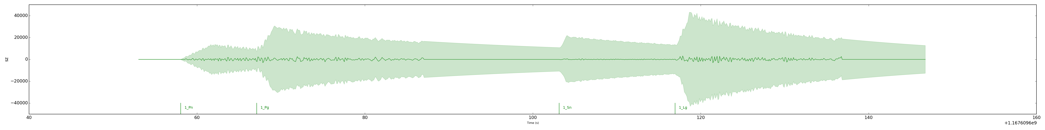
Forward model: Demo

Slide 25
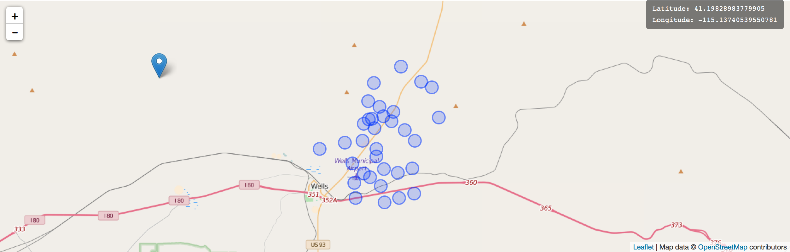
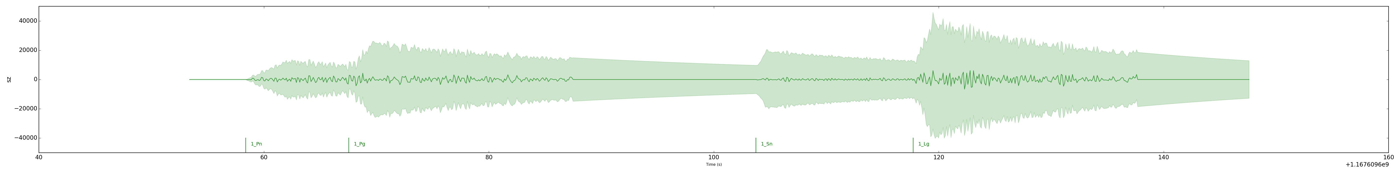
Forward model: Demo

Slide 26
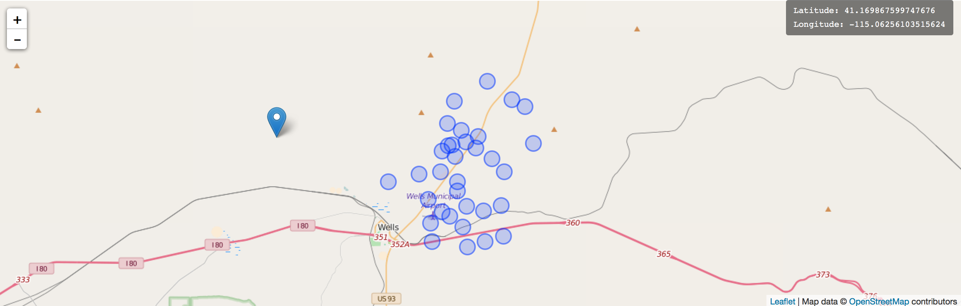
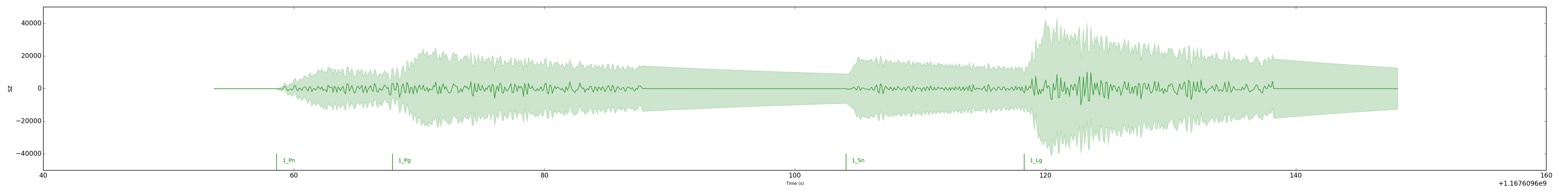
Forward model: Demo

Slide 27
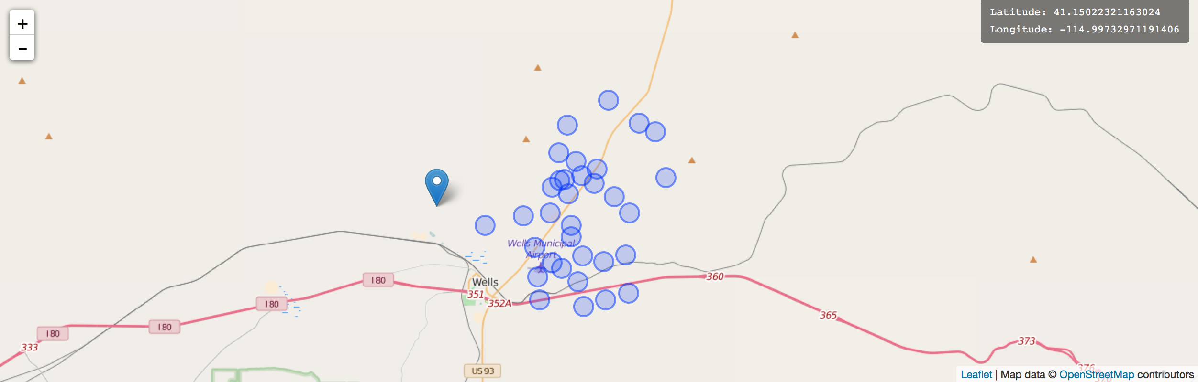
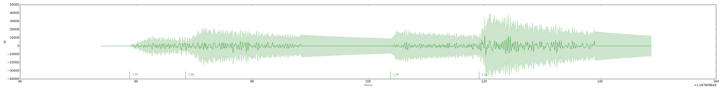
Forward model: Demo

Slide 28
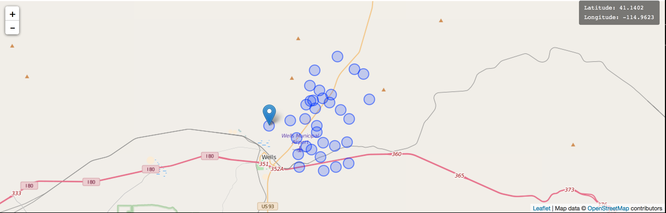
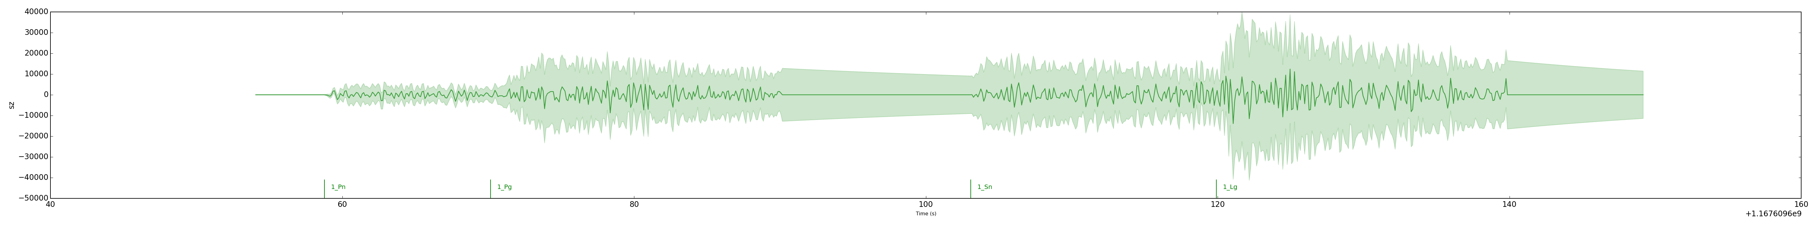
Forward model: Demo

Slide 29
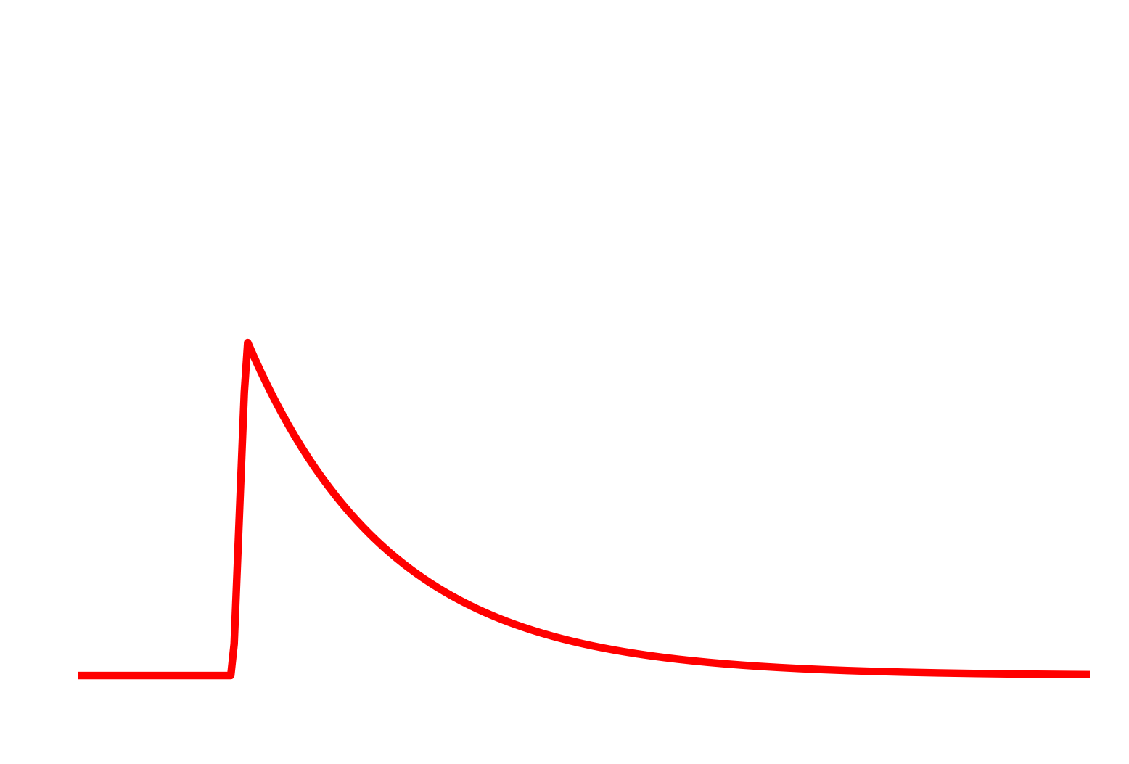
Inference: integrating out modulation process
T
Conditioned on envelope shape, each
signal z is Gaussian distributed:
z ~ N(TAw, R)
T: envelope shape = diag(t)
A: discrete wavelet transform
w: wavelet coefficients
R: autoregressive noise covariance
Given w ~ N(μ, Σ) from GP,
can marginalize:
z ~ N(TAμ, TAΣA’T + R)
Naïve evaluation is O(n³) time!
×
Aw
+
R
=
z
Notes:
Given prior on wavelet params, can compute signal probability in closed form as a Gaussian likelihood!

Slide 30
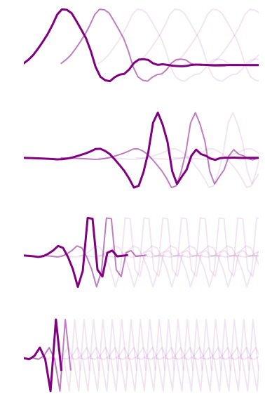
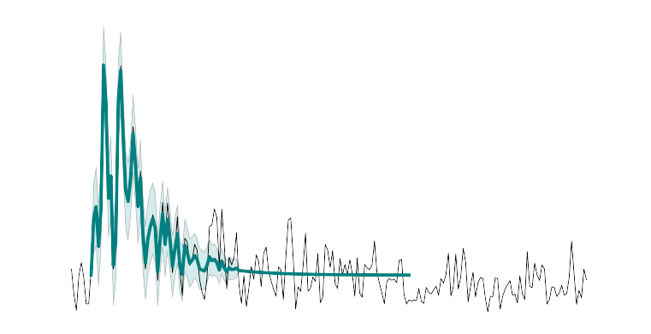
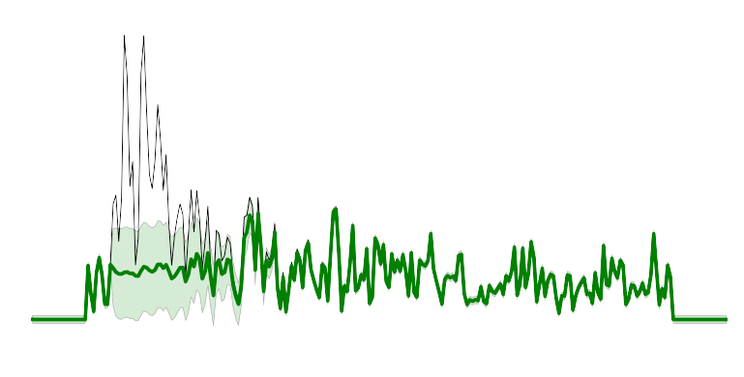
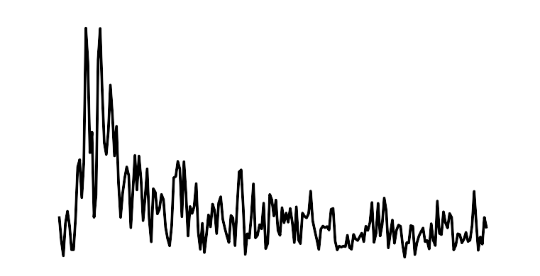
Inference: integrating out modulation process
Fast wavelet transforms exploit basis structure
O(n log n) time
Noisy observations + priors on coefficients -> need a Bayesian wavelet transform.
Can represent as a state-space model with state size O(log n); inference (Kalman filtering) in O(n log² n) time.
W⁽¹⁾
W⁽²⁾
W⁽³⁾
W⁽⁴⁾
Wavelet SSM
x₁
x₂
x₂
x₃
x₃
x₄
…
x₁
Markov noise process
z₁
z₂
z₃
z₄
Notes:
Naturally composes with state-space noise models (e.g. autoregressive).
(lots of extra details here, overlapping arrivals, implementing this efficiently using the structure of transition/obs models, incremental likelihood calculations, etc.)

Slide 31


Inference: reversible jump MCMC
Birth proposals:
Reversible jump moves:
Event birth and death
Event split and merge
Event re-proposal / mode-jumping
Phase birth/death
Hough transform
Random-walk MH moves:
Event location, depth, magnitude, time
Envelope shape parameters
AR noise parameters
GP kernel hyperparams (during training)
Waveform correlation
Notes:
\alpha(x'|x) = \min\left\{1, \frac{\textcolor{red}{
\pi(x')}q(x|x')}{\textcolor{red}{\pi(x)}q(x'|x)}\right\}

Slide 32
Monitoring the Western US
Two-week period following Feb 2008 event at Wells, NV (6.0).
Compare IMS-based systems:
Global Association / SEL3
LEB (human analysts)
NETVISA (detection-based Bayesian)
SIGVISA (this work, signal-based Bayesian)
Reference bulletin: ISC regional catalog, with Wells aftershocks from US Array.

Slide 33

Historical data (one year, 1025 events)

Slide 34
Evaluation
Match events to ISC reference bulletin (≤ 50s, ≤ 2° discrepancy)
Precision: of inferred events, % in reference bulletin.
Recall: of reference events, % that were inferred.
Location error: distance (km) from inferred to reference locations.

Slide 35

Precision / Recall
Sigvisa (all)
Sigvisa (top)

Slide 36

Recall by magnitude range

Slide 37


NETVISA (139 events)
Wells region

Slide 38


SIGVISA top events (393)
Wells region

Slide 39

Distribution of location errors (km)

Slide 40


Better than reference bulletin?
Likely mining explosion at Black Thunder Mine (105.21° W, 43.75° N, mb 2.6, PDAR)
Event near Cloverdale, CA (122.79° W, 38.80° N, mb 2.6, NVAR)

Slide 41
De novo events
Monitoring requires detection capability even with no known prior seismicity.
Define de novo as ≥ 50km from recorded historical event.
ISC bulletin contains 24 such events between January and March 2008.

Slide 42

De novo recall (# detected / 24)

Slide 43



De novo missed by SEL3/LEB
^{NVAR (distance 183km)}
^{YBH (distance 342km)}
ELK (distance 407km) NO DETECTIONS REGISTERED
Notes:
Event at 119.79◦W, 39.60◦N

Slide 44
Conclusions
We propose a model-based Bayesian inference approach to seismic monitoring.
Inverting a rich forward model allows our approach to combine:
Precise locations, as in waveform matching
Sub-threshold detections, as in waveform correlation
Noise reduction, as in array beamforming
Relative locations, as in double-differencing
Absolute locations for de novo events
Western US results: 3x recall vs SEL3 (2.6x vs NETVISA) at same precision, detects de novo events missed by detection-based systems.
Notes:
So in conclusion: modeling the actual signals gives you the precise locations that you'd get from waveform matching, along the sub-threshold detections from waveform correlations, the same kind of noise reduction as array beamforming but using the entire network, the precise relative locations you'd get from double differencing, while still including absolute travel times so you get locations for de novo events. And we do all of this in a unified Bayesian inference system that trades off all of these phenomena consistent with their uncertainties. So, we think this is a very promising approach to monitoring, the initial results are promising. And right now we're working to scale the system up to run on larger datasets so I think at the next SnT we'll be able to come back and show that this really is the next generation of monitoring after NET-VISA. Thanks.

